Slide 1
« SÉMINAIRE NATIONAL IMAGERIE OPTIQUE IN VIVO » 17 & 18 SEPTEMBRE 2015 – AVIESAN (PARIS) APPEL À MANIFESTATION D’INTÉRÊT OFFRE DE SERVICES
PLATE-FORME IMAGERIE ET CYTOMÉTRIE (PFIC) UMS AMMICa : Analyse Moléculaire, Modélisation et Imagerie de la maladie Cancéreuse (UMS 3655 CNRS / US 23 INSERM)
GUSTAVE ROUSSY CANCER CAMPUS, VILLEJUIF

Slide 2
1. DESCRIPTION & EXPERTISE
-
-
The PFIC is an integrated Imaging & Cytometry platform intended to support basic, translational and clinical research : services and developments are available to on site research teams and also to academic teams and to industry from outside Gustave Roussy .
The PFIC strives to provide :
Expertise in intravital photon imaging of : cancer cell, mouse model and patient,
A multidisciplinary approach for functional photon imaging and cytometry at molecular, cell and organ level,
Expertise in complex transmodalities imaging and quantitative cytometry,
A policy of sharing knowledge, and collaborating with local, national and international research teams.

Slide 3
2. SERVICES
Small animal whole body imaging (bioluminescence , fluorescence & CT)
Confocal and Multiphoton imaging, FLIM, FRAP , FRET, Photoactivation and Spectral imaging in-cellulo and in-vivo,
Long term live imaging (cell and small animal)
High resolution in-vivo, ex-vivo imaging (fluorescence and OCT) : Mice and Human,
Supplying of optical chambers and engraftment of optical chambers for high-resolution and minimally invasive in-vivo imaging in mice model
Supplying of new experimental set up for in-vivo imaging (high resolution imaging and fluorescent staining strategies) : Animal & Human,
Fluorescence imaging using fibered optical probes : Animal & Human,
Implementation and management of clinical research protocols in photonics : Full support for preclinical R&D to clinical. protocols in biophotonic ,
Data treatment and quantification.

Slide 4
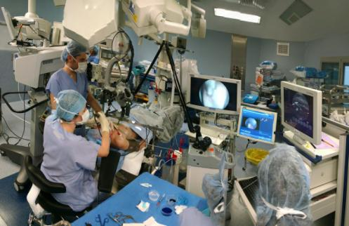
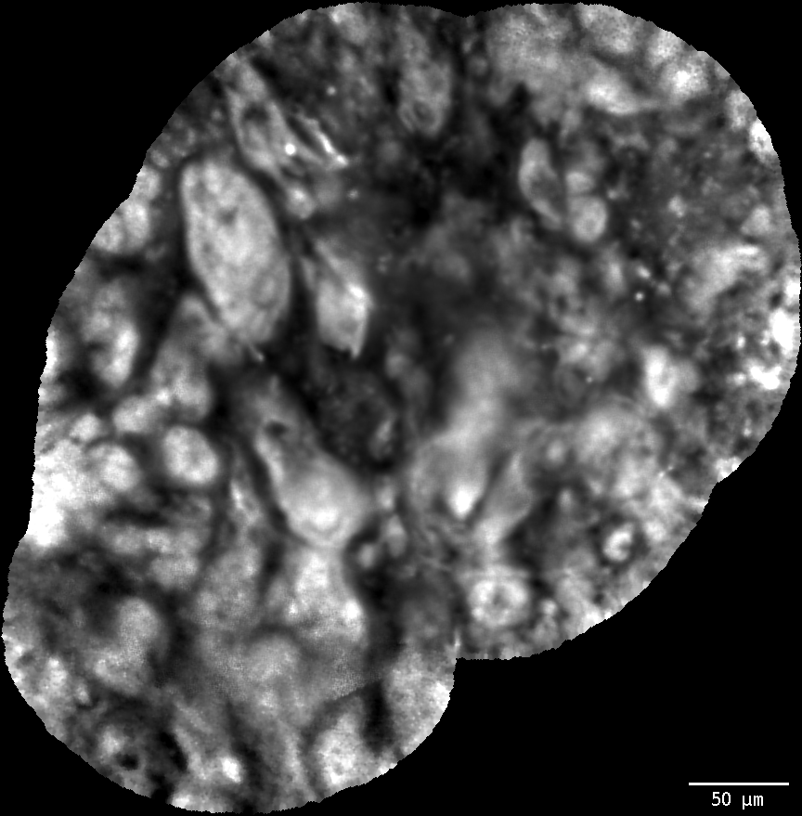
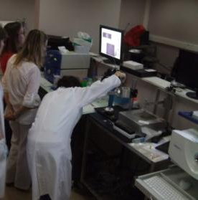
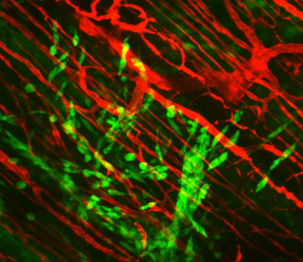
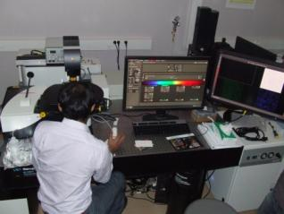
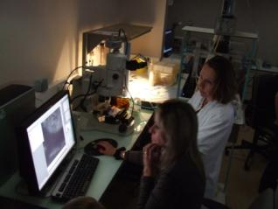
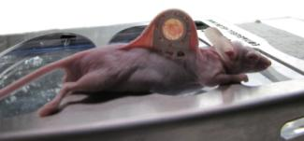
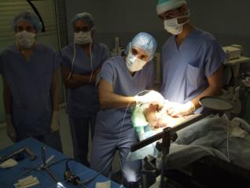
3. CONTACT
Contact : Corinne Laplace-Builhé
Tel : 01 42 11 66 72
E-mail : corinne.laplace@gustaveroussy.fr
Web : http://www.gustaveroussy.fr/fr/node/2335
http://www.ir4m.u-psud.fr/
La PFIC est soutenue par : Fondation

